Slide 1
Intro to ML and CNN’s
Romeo Šajina, mag. Inf.

Slide 2
Who am I?
My name is Romeo Šajina
I graduated from college three years ago
I work as a college assistant at the Faculty of Informatics in Pula (FIPU)
My preferred topics of research are neural networks and their application
Today I will talk about machine learning and convolutional neural networks

Slide 3
What is ML and why does it matter?
“Machine learning (ML) is the study of computer algorithms that can improve automatically through experience and by the use of data.” - Mitchell, Tom (1997)
It is seen as a part of artificial intelligence
Machine learning algorithms build a model based on sample data, known as training data, in order to make predictions or decisions without being explicitly programmed to do so.

Slide 4
What is ML and why does it matter?
We are given a task to recognize cats and dogs in the images.
The solution must be automated, so what can be our approach?
Logic and Rule-Based Approach
Machine Learning (Pattern-Based Approach)

Slide 5
Logic and Rule-Based Approach
What rules can we establish to distinguish cats from dogs:
Rule 1: dogs have bigger noses with respect to their head than cats
Numerical value (R1): how much area of the head does the nose occupies (nose area / head area)
Rule 2: dogs have bigger ears with respect to their head than cats
Numerical value (R2): the ratio between ears area and head area (ears area / head area)
Algorithm:
if R1 > 0.2 and R2 > 0.3 then it is a dog
if R1 < 0.2 and R2 < 0.3 then it is a cat
else I’m not sure what it is, perhaps we need more rules

Slide 6
Machine Learning (Pattern-Based Approach)
The computer must learn these rules by itself
Our task is to give the computer images and label what they contain
The computer will then run through the images multiple times and learn some rules (or better say: patterns) that will enable it to distinguish between cats and dogs

Slide 7
How does ML work?
Standard image explaining how does ML works:
values (R1 and R2) rules/patterns prediction (cat or dog)
Input
Model
Output

Slide 8
How does ML really work?
Simple neural network:
Input
Hidden Layer
Output
Output of classification is probability that image is certain object
Weights
Weights

Slide 9
How does ML really work?
Simple neural network (prediction based on ears and nose values):
3.46
R1
-6.3
dog
6.45
-5.92
-3.46
R2
cat
6.27

Slide 10
How does ML really work?
Calulations:
Dog example:
R1 = 0.5
R2 = 0.4
3.46
R1
0.5
-6.3
cat
-5.92
6.45
-3.46
R2
0.4
cat
6.27

Slide 11
How does ML really work?
Calulations:
(0.5 * (-6.3) + 0.4 * (-5.92)) + 3.46 = -2.06
Dog example:
R1 = 0.5
R2 = 0.4
3.46
R1
0.5
-6.3
-2.06
cat
-5.92
6.45
-3.46
R2
0.4
cat
6.27

Slide 12
How does ML really work?
Calulations:
(0.5 * (-6.3) + 0.4 * (-5.92)) + 3.46 = -2.06
(0.5 * 6.45 + 0.4 * 6.27) - 3.46 = 2.27
Dog example:
R1 = 0.5
R2 = 0.4
3.46
R1
0.5
-6.3
-2.06
cat
-5.92
6.45
-3.46
R2
0.4
-1.56
cat
6.27

Slide 13
How does ML really work?
Calulations:
(0.5 * (-6.3) + 0.4 * (-5.92)) + 3.46 = -2.06
(0.5 * 6.45 + 0.4 * 6.27) - 3.46 = 2.27
Apply sigmoid function on results:
sigmoid(-2.06, 2.27) = (0.01, 0.99)
Dog example:
R1 = 0.5
R2 = 0.4
3.46
R1
0.5
-6.3
-2.06
cat (0.01)
-5.92
6.45
-3.46
R2
0.4
-1.56
cat (0.99)
6.27

Slide 14
How does ML really work?
How about a “cat” example?

Slide 15
How does ML really work?
Calulations:
Cat example:
R1 = 0.1
R2 = 0.2
3.46
R1
0.1
-6.3
cat
-5.92
6.45
-3.46
R2
0.2
dog
6.27

Slide 16
How does ML really work?
Calulations:
(0.1 * (-6.3) + 0.2 * (-5.92)) + 3.46 = 1.64
Cat example:
R1 = 0.1
R2 = 0.2
3.46
R1
0.1
-6.3
1.64
cat
-5.92
6.45
-3.46
R2
0.2
dog
6.27

Slide 17
How does ML really work?
Calulations:
(0.1 * (-6.3) + 0.2 * (-5.92)) + 3.46 = 1.64
(0.1 * 6.45 + 0.2 * 6.27) - 3.46 = -1.56
Cat example:
R1 = 0.1
R2 = 0.2
3.46
R1
0.1
-6.3
1.64
cat
-5.92
6.45
-3.46
R2
0.2
-1.56
dog
6.27

Slide 18
How does ML really work?
Calulations:
(0.1 * (-6.3) + 0.2 * (-5.92)) + 3.46 = 1.64
(0.1 * 6.45 + 0.2 * 6.27) - 3.46 = -1.56
Apply sigmoid function on results:
sigmoid(1.64, -1.56) = (0.96, 0.04)
Cat example:
R1 = 0.1
R2 = 0.2
3.46
R1
0.1
-6.3
1.64
cat (0.96)
-5.92
6.45
-3.46
R2
0.2
-1.56
dog (0.04)
6.27

Slide 19
How does ML really work?
But how are these values determined?

Slide 20
Training
cat
dog
Model
cat
dog
cat
dog

Slide 21
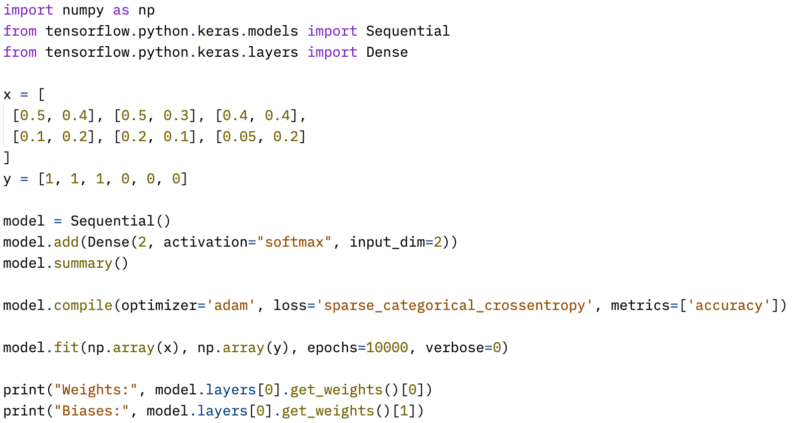
Simple fully connected NN - Python

Slide 22
Image classification
Computers work only with numbers, images are also numbers
what we see:
what computer see:

Slide 23
Image classification
Can we just create a big enough model to work with all pixels of the image?
Yes
But, an RGB image has dimensions in the shape of width x height x 3 which means that a Full HD image will have 1920 x 1080 x 3 = 6 million+ values
Not all values are important, maybe we can scan the image to find the most important parts?

Slide 24
Convolutional Neural Network - CNN
CNN was originally proposed by Y. LeCun as an architecture that can do better image classification than previous solutions
one of the most significant discoveries that contributed today’s neural network popularity
specialized for processing grid-shaped data (images are one example of it)

Slide 25
Convolutional Neural Network - CNN
A convolutional neural network is yet another type of neural network. From the conceptual point of view, it looks like a normal neural network. The only difference is special layers called Convolutional layers hence the name CNNs.

Slide 26
Operation of convolution
Matrix (eg. image)
Filter (kernel)
Output matrix

Slide 27
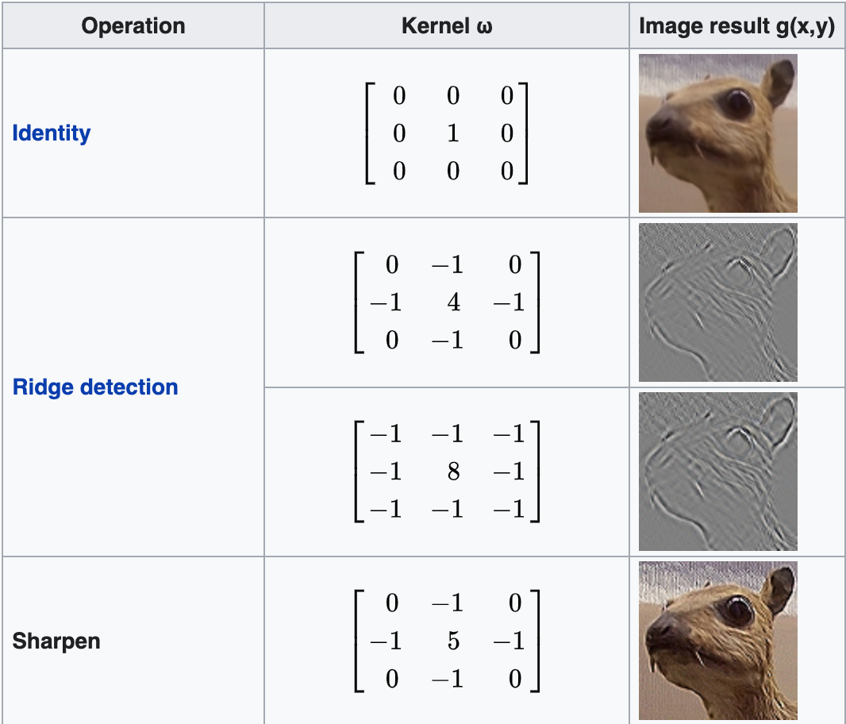
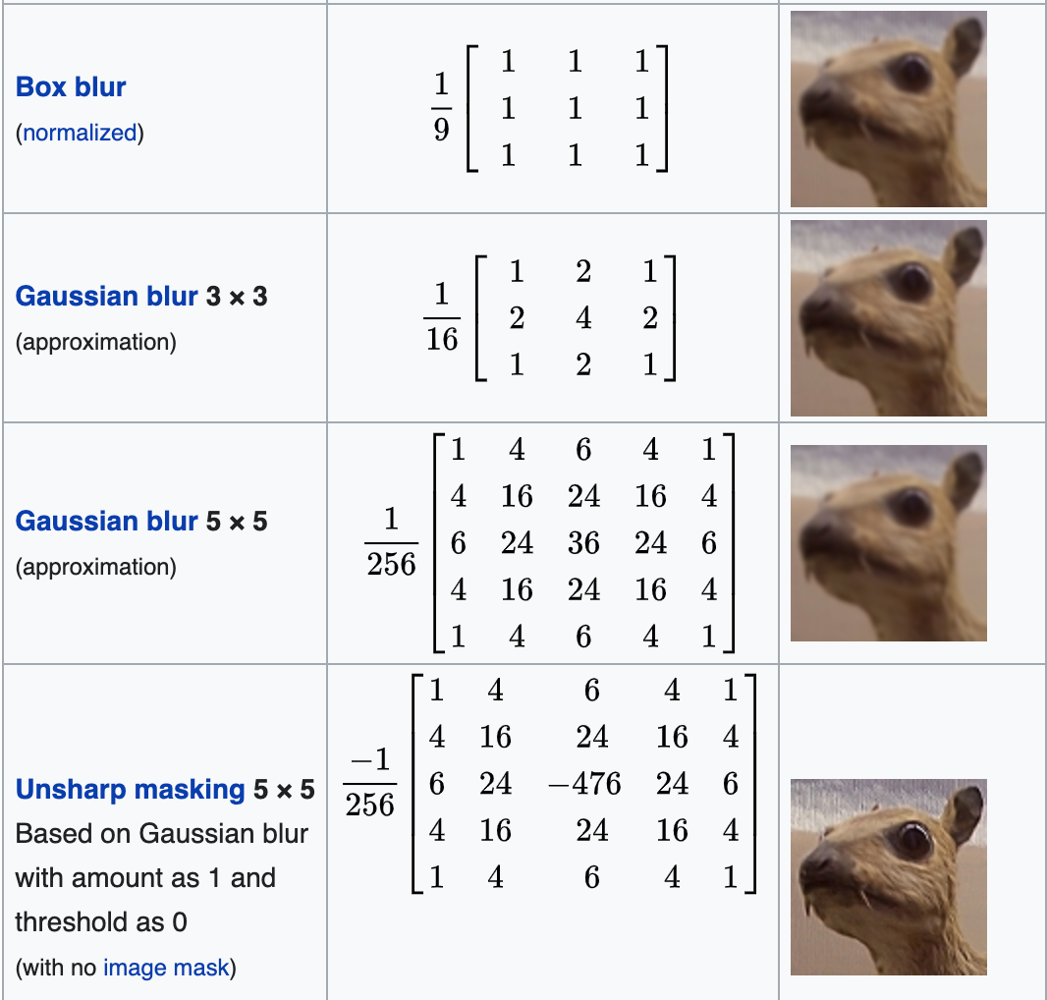
Operation of convolution

Slide 28
CNN – Convolutional layer
We have the following matrix (simple image of number one):
The process of convolving can be seen in demo.xlsx-Convolving
0 | 0 | 1 | 0 | 0
0 | 1 | 1 | 0 | 0
0 | 0 | 1 | 0 | 0
0 | 0 | 1 | 0 | 0
0 | 0 | 1 | 0 | 0
2 | 2 | 2
1 | 1 | 1
0 | 0 | 0
4 | 4 | 3
5 | 5 | 3
3 | 3 | 3
*
=

Slide 29
CNN – Convolutional layer (Padding)
From the previous example, we can see that we used the filter to extract important features/edges from input data. But one thing is to notice: the size of the input matrix has shrunk. Sometimes that is not important but imagine some useful information was contained in the corners of the input data and after convolution, it was gone.
To battle this problem we have to apply padding to our input data. There is two kinds of padding:
valid
same
Previously we saw valid padding which means no change to input data.
When we use the same padding our input data is padded with zeros to keep the original data size in the output. The number of rows and columns of zeros padded around data is determined by the size od the data and filter size.
Paddings can be seen in demo.xlsx-Padding

Slide 30
CNN – Convolutional layer (Stride)
There is another parameter we can control called stride. We mentioned that in process of convolving we move the filter across the matrix pixel by pixel from the left-upper corner to the down-right corner.
The stride parameter is then defined as 1 or (1, 1) which means that we slide a filter pixel by pixel.
Setting different values for this parameter will alter sliding behavior, the first part of the parameter is the number of pixel to slide towards the right and second part is the number of pixels to slide towards the bottom (eg. (2, 2) or 2, (3, 3) or 3, etc).
Strides can be seen in demo.xlsx-Stride

Slide 31
CNN – Pooling layer
A pooling layer is a kind of layer that reduces the dimension of the input data while extracting it's most important features.
Typically added after convolution layer in CNN
A few versions:
Mean pooling: calculates mean within the pooling frame.
Sum Pooling: sum of values within the pooling frame.
Max pooling: takes a maximum value within the pooling frame. This version is more widely used.
The pooling layer work similarly to the convolutional layer, i.e. it doesn’t do matrix multiplication with filter
Pooling can be seen in demo.xlsx-Pooling

Slide 32

Complete CNN network
We are now ready to complete our CNN network
Notes:
CNN's are usually build by adding convolution layers at the beginning of the network, then pooling layer, convolution layer and so on. At the end of the network we then add a few fully connected (Dense) layers and of course our class outputs at the end.

Slide 33
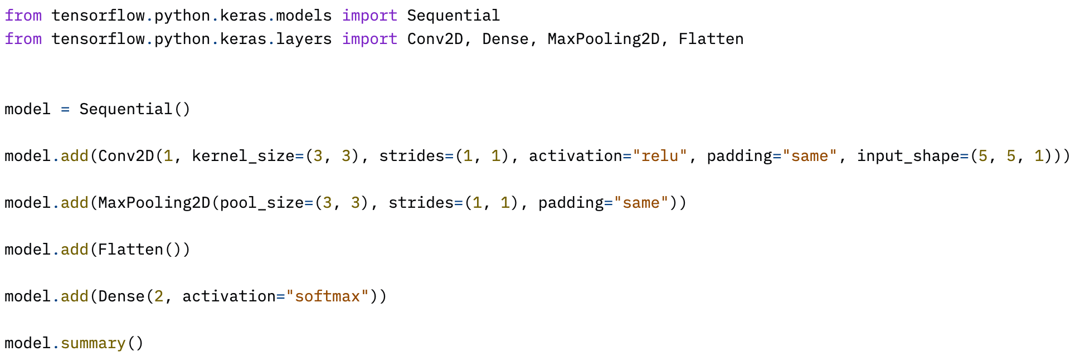
Complete CNN network - Python
Full network can be seen in demo.xlsx-Full network

Slide 34
The end
All materials are available online:
Presentation
Demo excel with operations
Python jupyter notebook
Link: https://github.com/RomeoSajina/AI-Tutorials/tree/master/intro-to-ml-and-cnns
or: https://bit.ly/3uzfIq9
Where to next:
Visualize neural network model with TensorSpace.js
Configure and test your NN in the browser with Neural network playground

